Slide 1


User Input,
Angular Bootstrap, UI/UX
Speaker:
Maxym Komarnytsky

Slide 2

User experience (UX) refers to a person's emotions and attitudes about using a particular product, system or service.
User interface (UI), in the industrial design field of human–computer interaction, is the space where interactions between humans and machines occur.

Slide 3


Slide 4
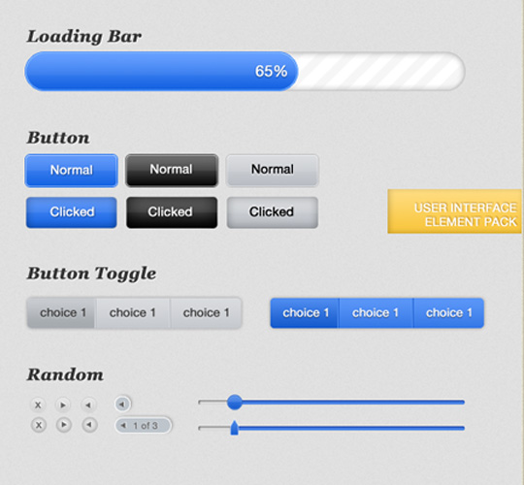
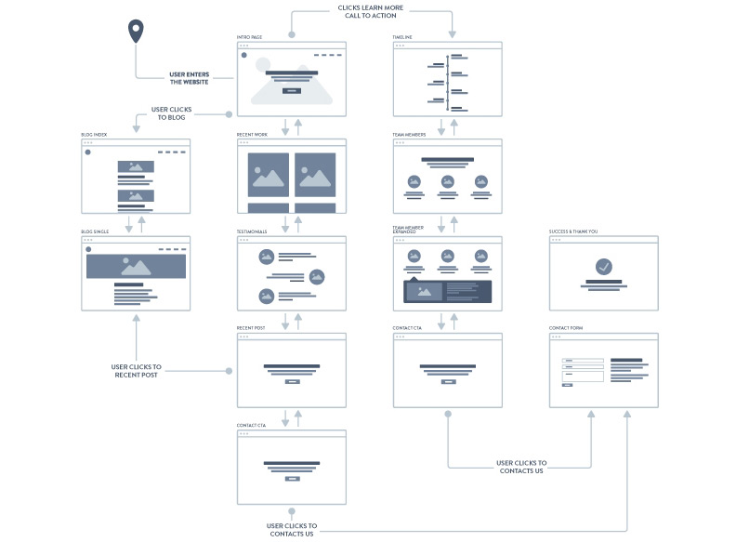
UX vs UI: Difference
UX includes the way a user interacts with the design, the user flow, and the overall functionality of the website or application
UI includes all of the buttons, controls and design elements of a website or application

Slide 5


UX vs UI: Difference
UX designers focus on the people who will actually be using the design
UI designers focus on the look and feel of the design

Slide 6
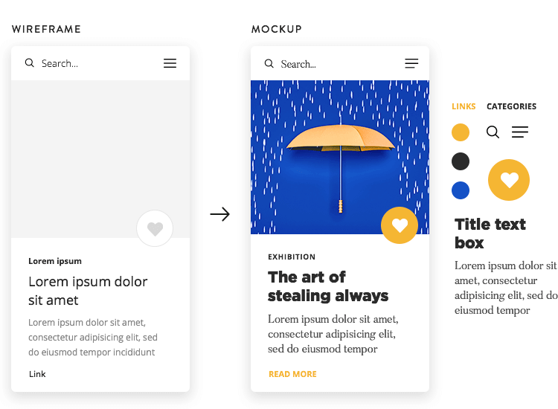
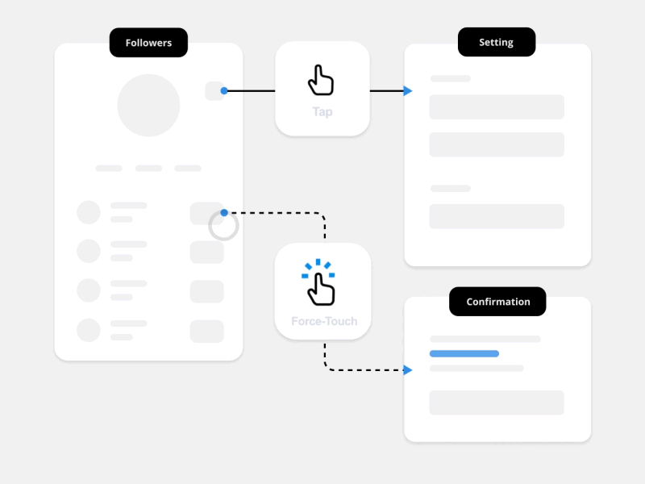
UX vs UI: Difference
UX designers create wireframes and testable prototypes
UI designers create finished, polished designs

Slide 7
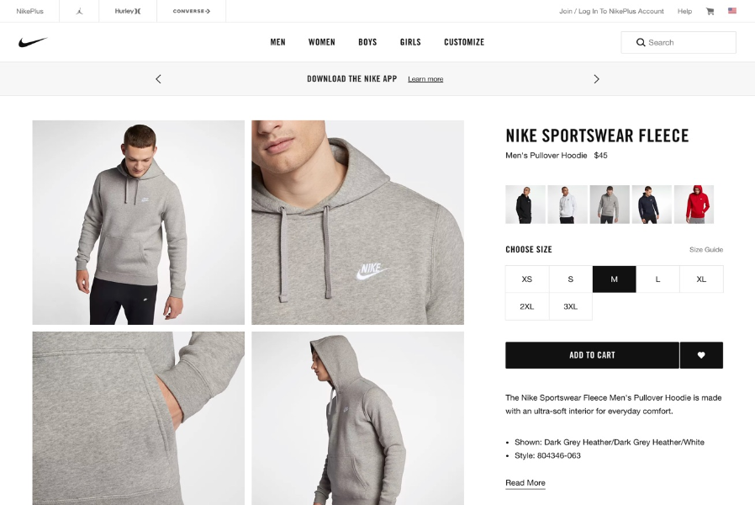

UX vs UI: Difference
UX designers work on the overall user flow of a site or app and how parts fit together
UI designers work on individual pages and interactions

Slide 8


UX vs UI: Difference
UX focuses more on the functionality and purpose of the design. UI designer focus on solving a problem
UI include artistic component. UI designers focus on creating a design that is attractive

Slide 9
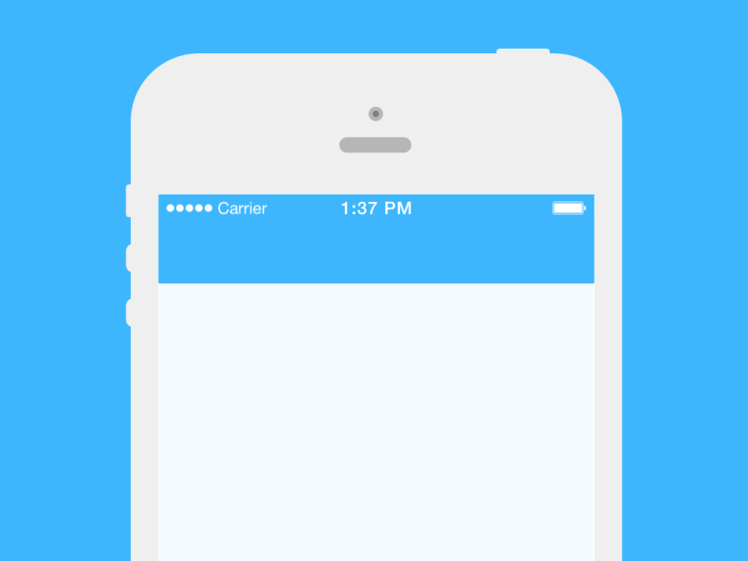
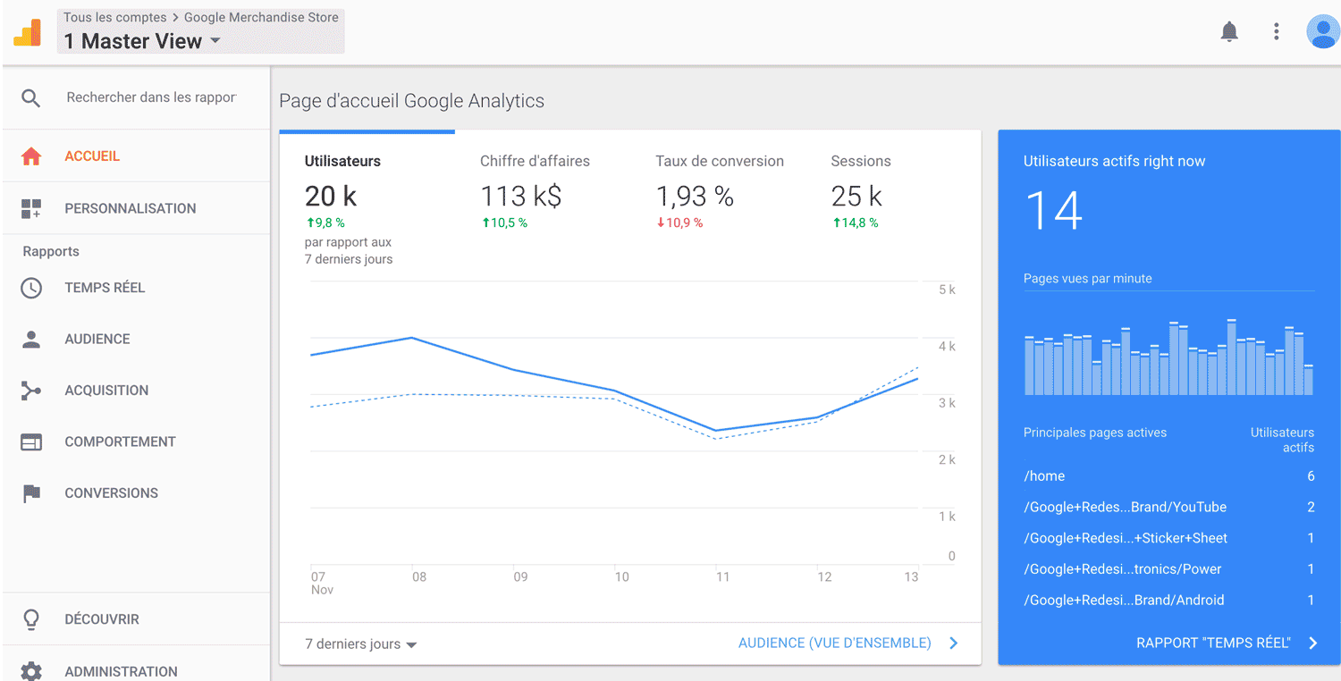
UX vs UI: Difference
UX design is mostly data-driven
UI design is often based on patterns, established best practices, and personal preferences

Slide 10
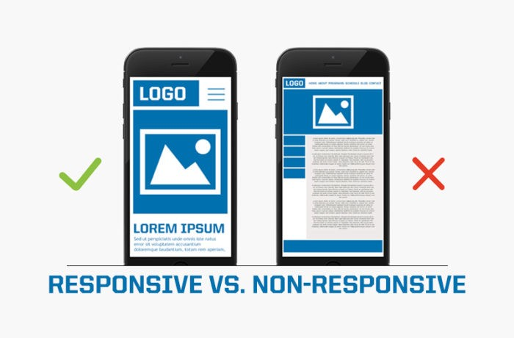
Not-responsive design

Slide 11
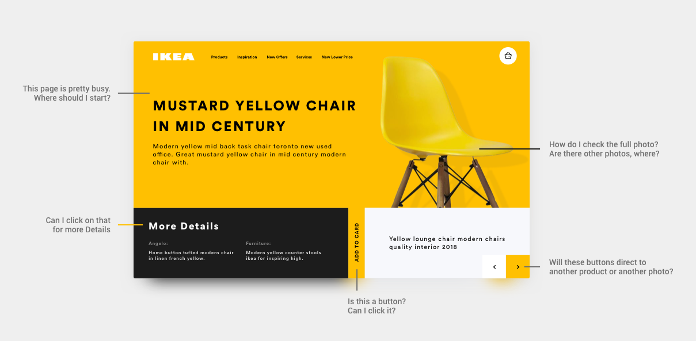
Unintuitive Navigation

Slide 12

Designing without content

Slide 13
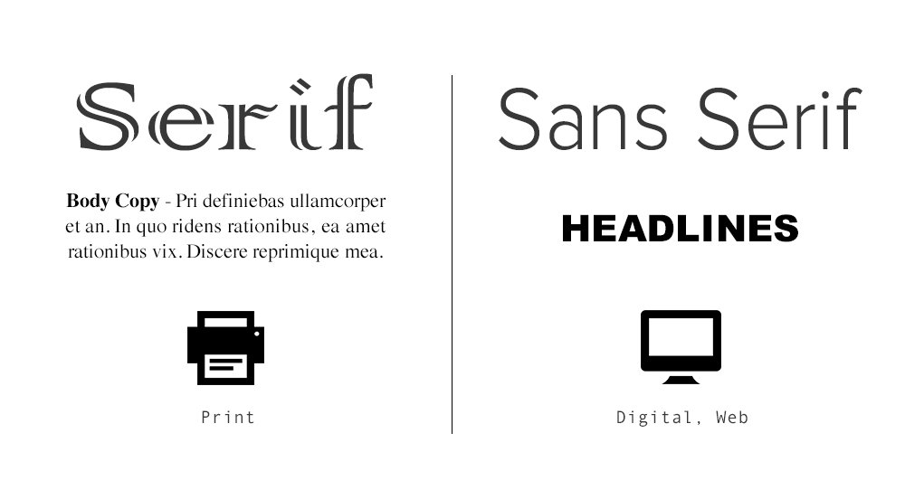
Hard-to-Read Fonts
Golden rules for line spacing:
-For optimal readability aim for about 140%-180%
-Limit line length to 70–80 characters.
-Font size should be minimum 16pt.
-Small fonts need more spacing.
-Check your line spacing when you change font or font size.

Slide 14
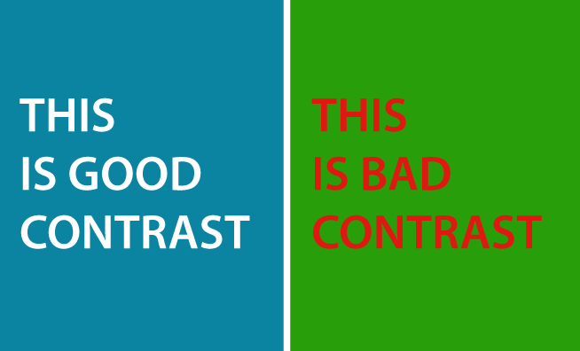
Poor Contrast

Slide 15
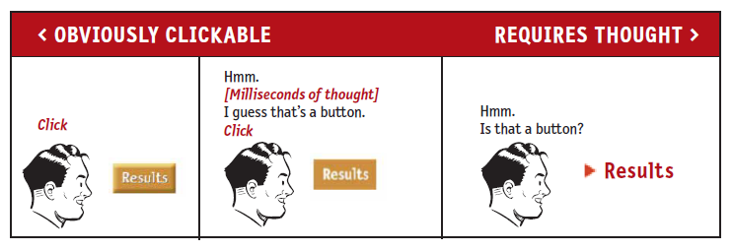
Unintuitive Buttons

Slide 16
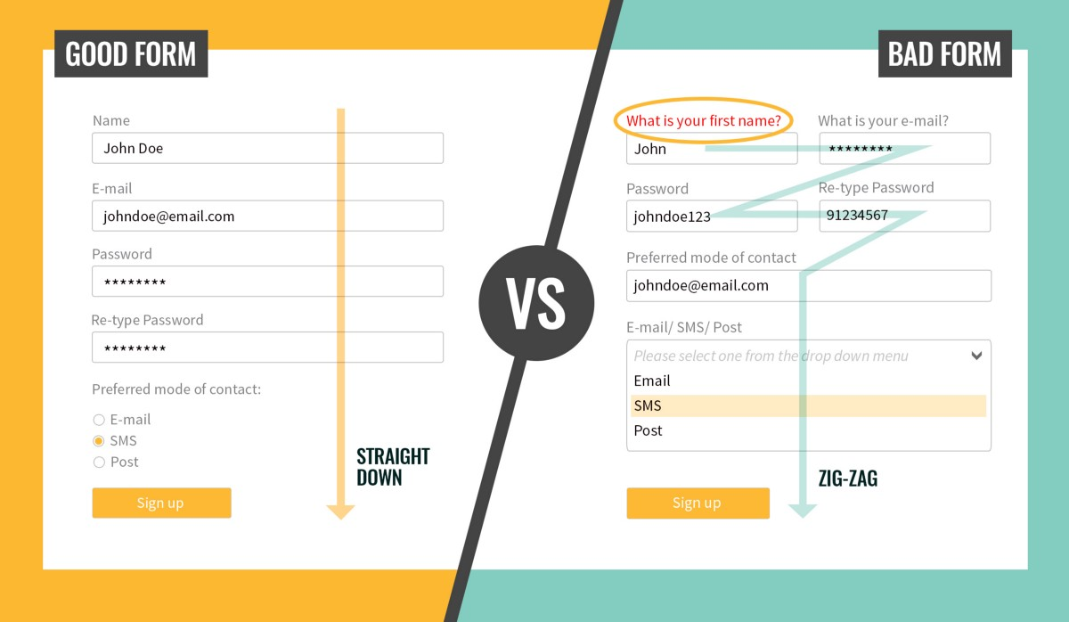
Bad Form

Slide 17
User Input
<input type="button">
<input type="checkbox">
<input type="color">
<input type="date">
<input type="datetime-local">
<input type="email">
<input type="file">
<input type="hidden">
<input type="image">
<input type="month">
<input type="number">
<input type="password">
<input type="radio">
<input type="range">
<input type="reset">
<input type="search">
<input type="submit">
<input type="tel">
<input type="text">
<input type="time">
<input type="url">
<input type="week">
Notes:
https://www.w3schools.com/html/html_form_input_types.asp

Slide 18
Input Attributes
autocomplete
autofocus
form
formaction
formenctype
formmethod
formnovalidate
formtarget
height and width
list
min and max
multiple
pattern (regexp)
placeholder
required
step
Notes:
https://www.w3schools.com/html/html_form_attributes.asp

Slide 19
Angular user input
@Component({
selector: 'app-click-me',
template: `
<button (click)="onClickMe()">Click me!</button>
{{clickMessage}}`
})
export class ClickMeComponent {
clickMessage = ' ';
onClickMe() {
this.clickMessage = 'You are my hero!';
}
}

Slide 20
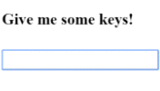
Angular user input
template: `
<input (keyup)="onKey($event)">
<p>{{values}}</p>
`
export class KeyUpComponent_v1 {
values = '';
onKey(event: any) { // without type info
this.values += event.target.value + ' | ';
}
}

Slide 21
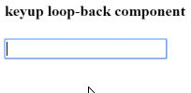
Angular user input
@Component({
selector: 'app-loop-back',
template: `
<input #box (keyup)="0">
<p>{{box.value}}</p>
`
})
export class LoopbackComponent { }

Slide 22
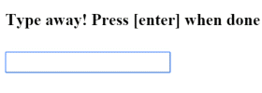
Angular user input
@Component({
selector: 'app-key-up3',
template: `
<input #box (keyup.enter)="onEnter(box.value)">
<p>{{value}}</p>
`
})
export class KeyUpComponent_v3 {
value = '';
onEnter(value: string) { this.value = value; }
}

Slide 23
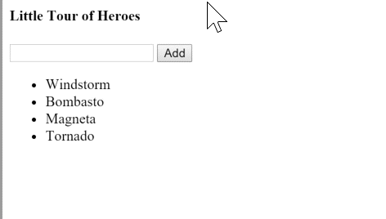
Angular user input
@Component({
selector: 'app-little-tour',
template: `
<input #newHero
(keyup.enter)="addHero(newHero.value)"
(blur)="addHero(newHero.value); newHero.value='' ">
<button (click)="addHero(newHero.value)">Add</button>
<ul><li *ngFor="let hero of heroes">{{hero}}</li></ul>`
})
export class LittleTourComponent {
heroes = ['Windstorm', 'Bombasto', 'Magneta', 'Tornado'];
addHero(newHero: string) {
if (newHero) {
this.heroes.push(newHero);
}
}
}

Slide 24


Angular Bootstrap and Angular Material
Notes:
https://angular-ui.github.io/bootstrap/
https://www.tutorialspoint.com/angular_material/index.htm

